Slide 1
Engaging apprentices
Stephanie Millar, Development Advisor, sparqs
Megan McHaney, Policy and Public Affairs Officer, NUS Scotland

Slide 2
Are apprentices really “harder to reach”?
Stephanie Millar, sparqs

Slide 3
SFC statistics 2012-13
Mode of attendance of course | Count | % of overall
Short full-time | 13,361 | 5%
Block release | 4,588 | 2%
Part-time (Day Release) | 29,094 | 11%
Other Part-time Day Course | 75,234 | 28%
Evenings & Weekends only | 26,78 | 10%
Assessment of Work Based Learning | 6,965 | 3%
Distance Learning | 6,744 | 3%
Open learning or directed private study systems | 10,107 | 4%
Flexible learning | 14,834 | 6%
Full-Time | 78,393 | 29%
Part-Time, but previously met old full-time criteria | 1,966 | 1%

Slide 4
Student Engagement Framework for Scotland
There are five key elements:
Students feeling part of a supportive institution.
Students engaging in their own learning.
Students working with their institution in shaping the direction of learning.
Formal mechanisms for quality and governance.
Influencing the student experience at national level.

Slide 5
Student Engagement Framework for Scotland
There are six features:
A culture of engagement.
Students as partners.
Responding to diversity.
Valuing the student contribution.
Focus on enhancement and change.
Appropriate resources and support.

Slide 6
Student
views
Dialogue
with staff
Improved learning
experience

Slide 7
What do we know?
One size doesn’t fit all.
Transposing “standard” mechanisms rarely works.
You need to know what non-FT students think.
Non-FT students have things to tell you.
Non-FT students can be engaged….

Slide 8
Task
Using element …
4. Formal mechanisms for quality and governance.
…. think what methods colleges use to engage their students.

Slide 9
Using four aspects of element 4 answer the following:
What might be exclusionary about this?
How could you fix this?

Slide 10
The apprentice Student Learning Experience

Slide 11
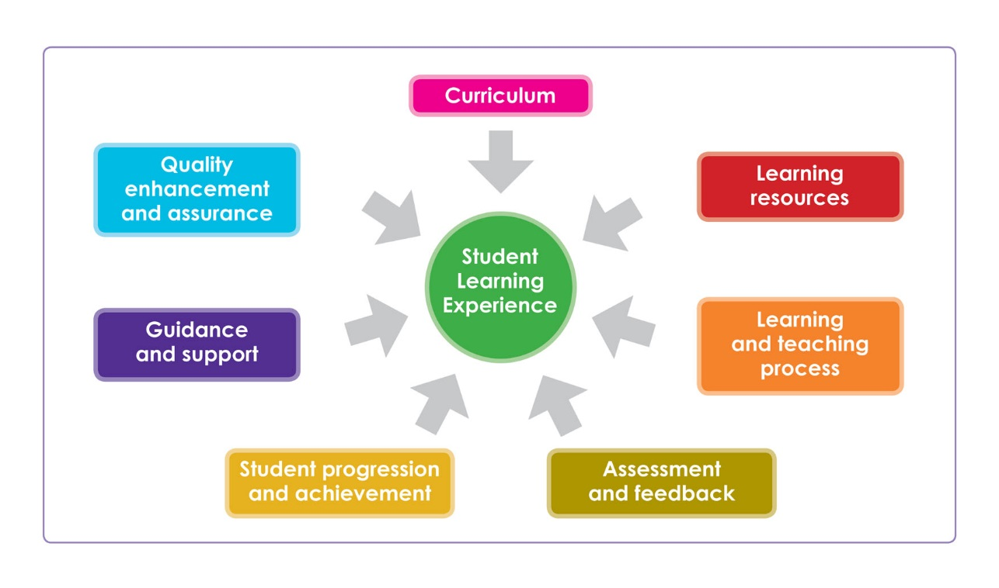

Slide 12
College/Students’ Association partnerships

Slide 13
Classroom
College
Nationally

